Slide 1
Street Cleanliness Detector
An AI-Powered CNN Web Application to Classify Street Conditions
Dharanisha
Internship Project | Rasa.ai
Loyola College | May 2, 2026 – June 2, 2026

Slide 2
Project Overview
🎯 Objective
💡 Solution
📊 Dataset
✅ Outcome
Detect whether a street is Clean or Dirty using a CNN model and serve predictions via a web application.
A full-stack AI app with a Flask REST API backend and React.js frontend connected to a trained CNN model.
155 labeled street images split into 121 training and 34 test images across Clean and Dirty categories.
End-to-end working web app with 82.35% validation accuracy and real-time image prediction capability.

Slide 3
Technologies Used
🧠 Machine Learning
⚙️ Backend
🖥️ Frontend
TensorFlow & Keras
Python 3.12
React.js
Convolutional Neural Network
Flask Framework
JavaScript ES6+
Data Augmentation
Flask-CORS
HTML5 / CSS3
Dropout + Early Stopping
NumPy
Fetch API
Binary Classification
SciPy
FormData

Slide 4
CNN Model Architecture
Input Layer
128 × 128 × 3 (RGB Image)
📋 Model Parameters
▼
Input Size
128 × 128 × 3
Conv2D + Pool
32 filters, 3×3, ReLU + MaxPool
▼
Optimizer
Adam (lr = 0.0001)
Conv2D + Pool
64 filters, 3×3, ReLU + MaxPool
Loss Function
Binary Crossentropy
▼
Conv2D + Pool
128 filters, 3×3, ReLU + MaxPool
Output Activation
Sigmoid
▼
Prediction Threshold
0.5
Flatten
Convert feature maps to vector
Training Images
121
▼
Dense + Dropout
128 neurons, ReLU + Dropout(0.5)
Test Images
34
▼
Epochs
20
Output Layer
1 neuron, Sigmoid → Clean / Dirty
Best Val Accuracy
82.35%

Slide 5
Dataset & Training Strategy
🟢 Clean Streets
🔴 Dirty Streets
🔧 Augmentation & Fixes
Train: ~60 images
Train: ~61 images
Rotation (±20°)
Test: ~17 images
Test: ~17 images
Zoom (±20%)
80 / 20 split
80 / 20 split
Horizontal Flip
Brightness Variation
Total: 155 Images | 121 Train | 34 Test
Dropout (0.5)
Early Stopping (patience=5)
Adam lr = 0.0001
20 Epochs Max

Slide 6
Backend Setup — Flask API
⚙️ Installation Commands
🚀 Run Backend
$ pip install flask
$ python app.py
$ pip install flask-cors
$ pip install tensorflow
Expected Output:
$ pip install numpy
✅ Model loaded successfully!
$ pip install scipy
* Running on http://127.0.0.1:5000
$ pip install h5.Py
* Running on http://0.0.0.0:5000
Flask API Endpoint:
$ python train.py
POST http://127.0.0.1:5000/predict

Slide 7
Frontend Setup — React.js
📦 Installation
⚡ Run Order — Critical!
$ cd street-frontend
Step 1
Open Terminal 1
cd street.py folder
$ npm install
Step 2
Start Flask
$ npm start
python app.py
Step 3
Open Terminal 2
Expected Output:
cd street-frontend folder
Compiled successfully!
Step 4
Start React
Local: http://localhost:3001
npm start
Step 5
Open Browser
http://localhost:3001

Slide 8
End-to-End Application Flow
👤
🖼️
⚛️
🐍
🧠
✅
User
Upload
React UI
Flask API
CNN Model
Result
→
→
→
→
→
Opens browser localhost:3001
Selects street image file
Sends POST request to Flask
Receives image preprocesses it
Predicts Clean or Dirty score
Displays label + confidence %
🔢 Prediction Logic: Output < 0.5 → 🟢 CLEAN | Output ≥ 0.5 → 🔴 DIRTY

Slide 9
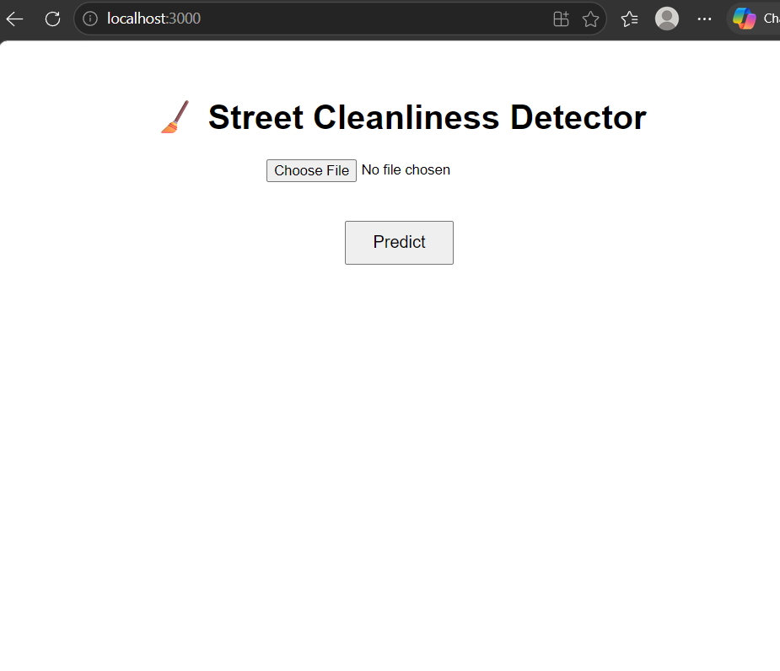
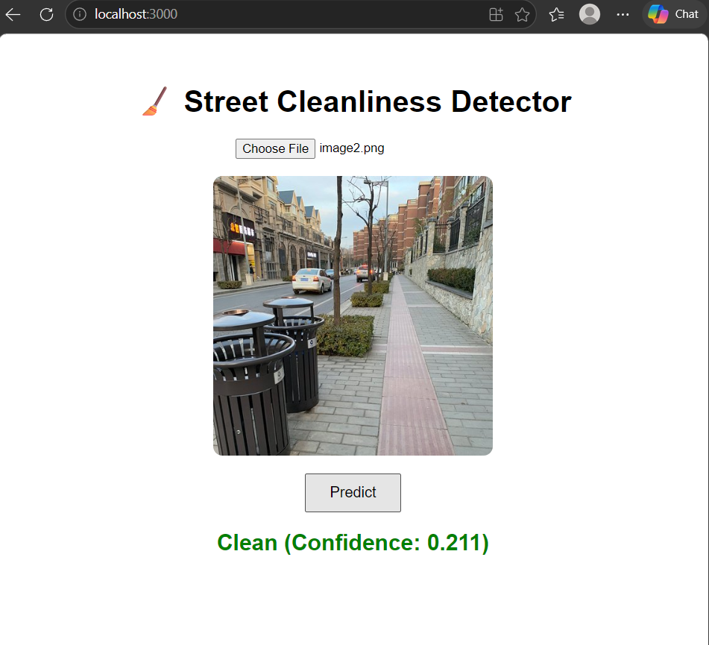
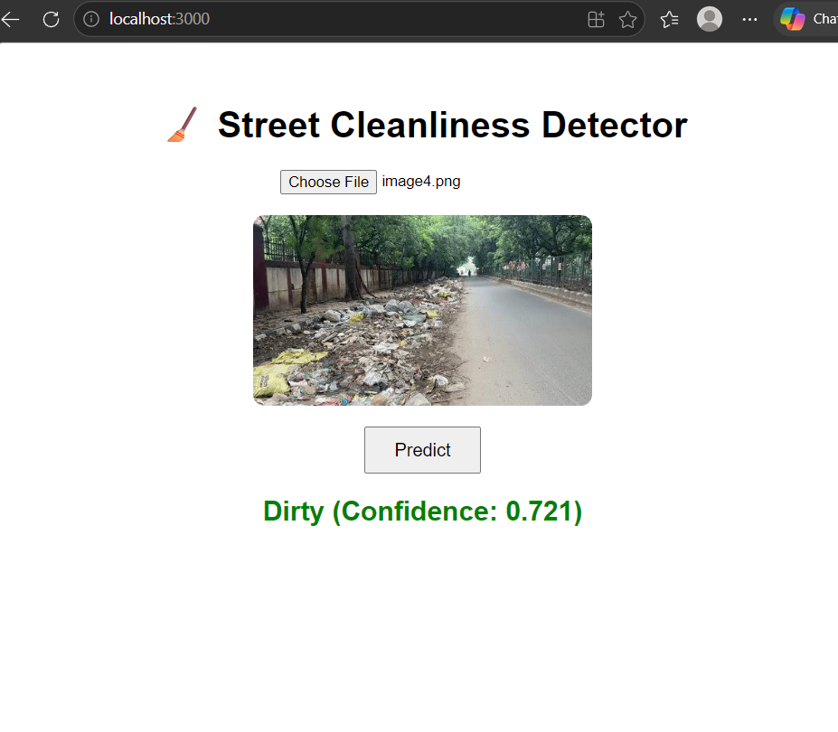
Output Screenshots
Home Page
Clean Street Result
Dirty Street Result
📷 Screenshot Placeholder (Add your screenshot here)
📷 Screenshot Placeholder (Add your screenshot here)
📷 Screenshot Placeholder (Add your screenshot here)
UI loads at http://localhost:3001
Prediction: Clean Confidence shown: 0.211
Prediction: Dirty Confidence shown: 0.721
💡 To add screenshots: Replace placeholder boxes with actual images from your running application.

Slide 10
Conclusion & Future Scope
🚀 Future Improvements
🏆 Achievements
Switch to MobileNetV2 for higher accuracy
✅ Full-stack AI web app built end-to-end
Collect 200+ images per class
✅ CNN model with 82.35% validation accuracy
✅ Real-time prediction via React + Flask
Add confidence progress bar in UI
✅ Data augmentation improved model robustness
Deploy on cloud (Render / Railway)
✅ Deployed locally with clean UI
Map integration to report dirty streets
Mobile app version
Dharanisha | Street Cleanliness Detector | Rasa.ai Internship | May–June 2026

